Slide 1
Intercepting HTTP Request with Filters

Slide 2
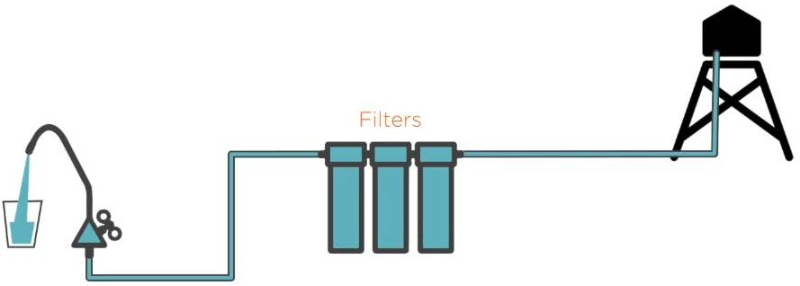
What Are Filters?

Slide 3
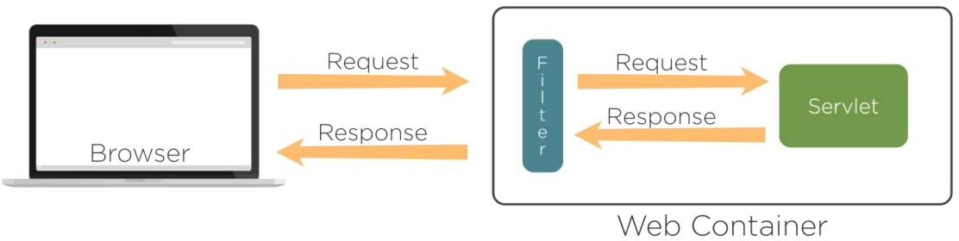
Servlets Filters

Slide 4

Introduced from Servlets 2.3 Specification
-Part of J2EE 2.3 Specification
Replaces Servlet Chaining or Chaining Servlets

Slide 5
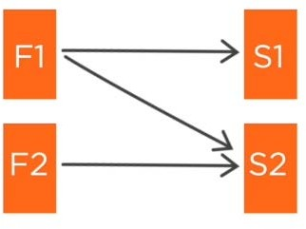
What Are Servlet Filters?
Servlet filter is a small amount of code that executes before or after serving up a web resource

Slide 6
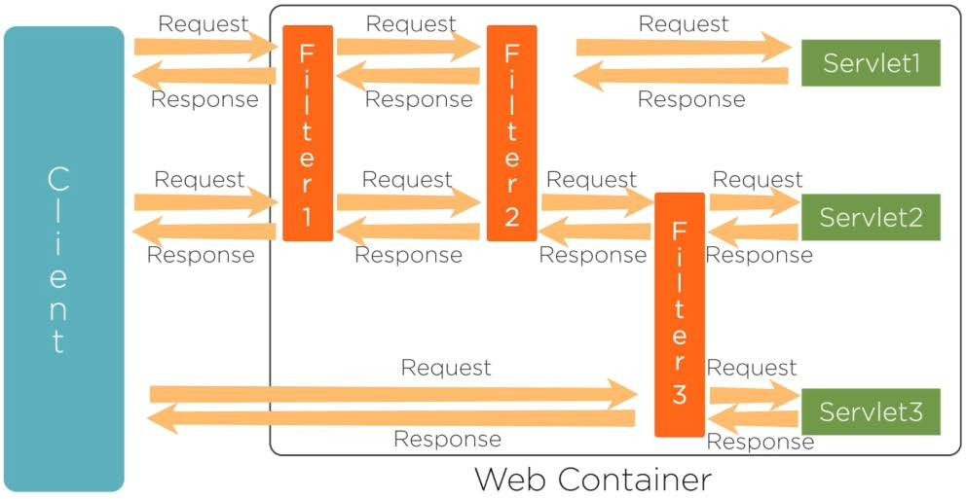
Servlet Filter

Slide 7
Why We Need a Servlet Filter?
Perform application task
Ability to reuse without rebuilding the application Applied by configuration
Using the filter interface we can implement a task They can be chained together
Initialization parameters
Have access to ServletRequest Have access to ServletContext

Slide 8
Use of Servlet Filters
Record all the incoming requests
Log the IP addresses of the computers Conversions
Data compressions Encryption and Decryption Input validations
Authentication and Authorization Audit access to sensitive resources
Email system administrators on every application To make the application perform better

Slide 9
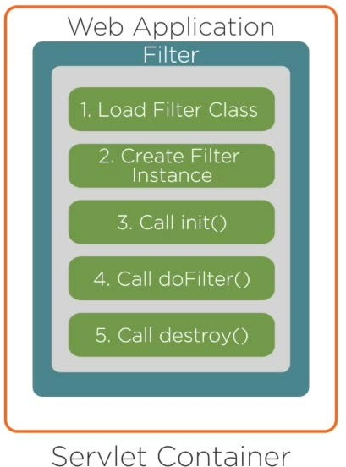
Servlet Filter Life Cycle

Slide 10
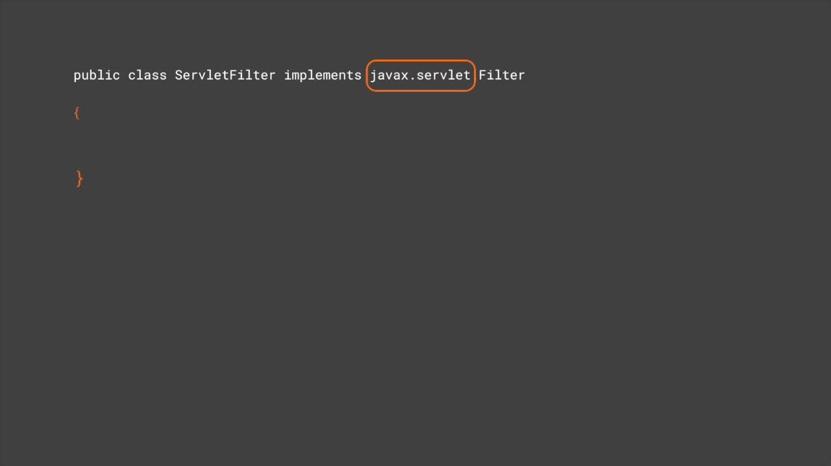

Slide 11
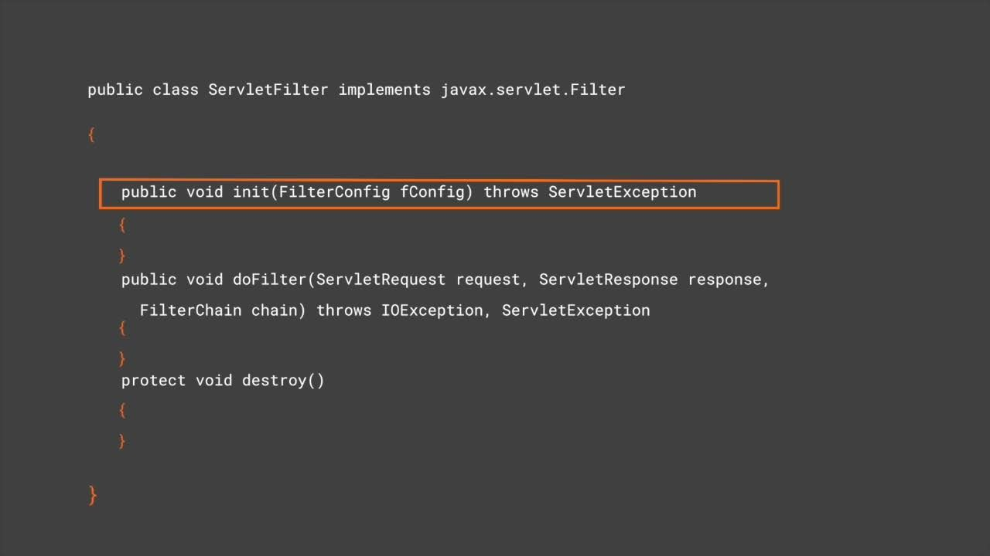

Slide 12
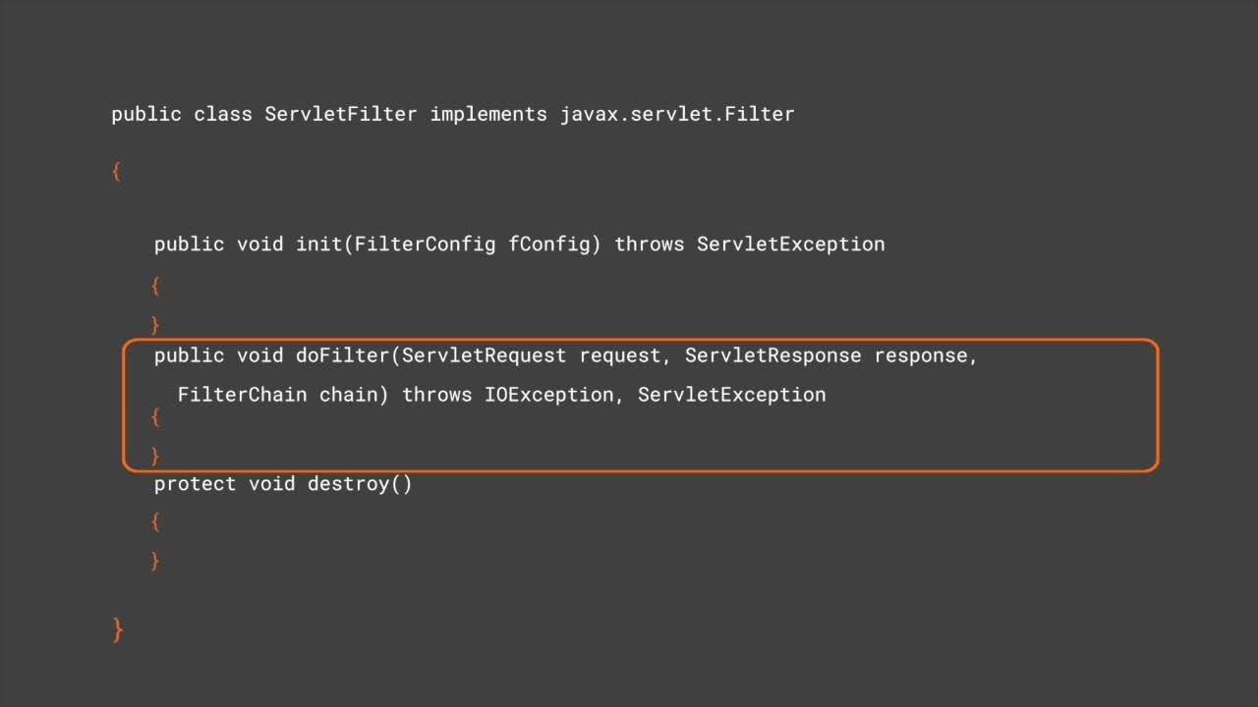

Slide 13
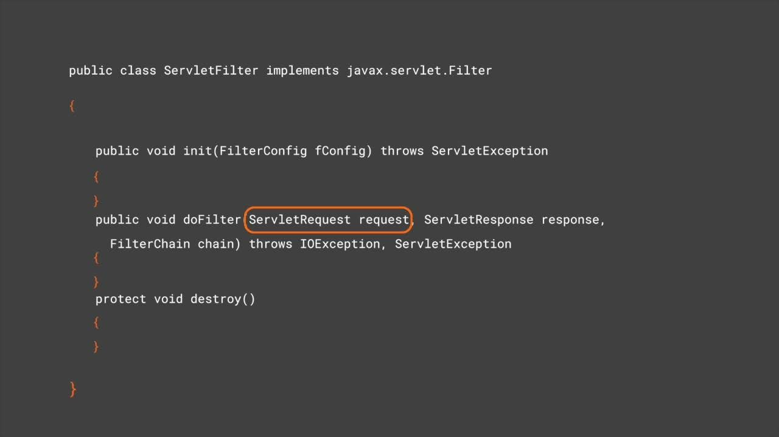

Slide 14
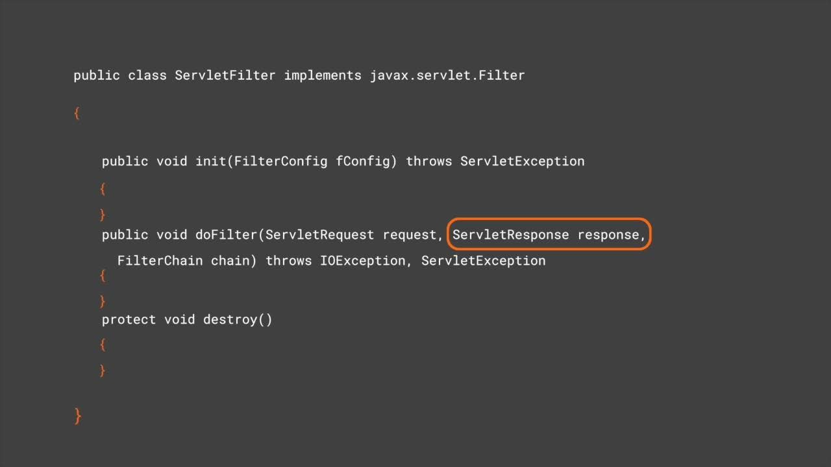

Slide 15
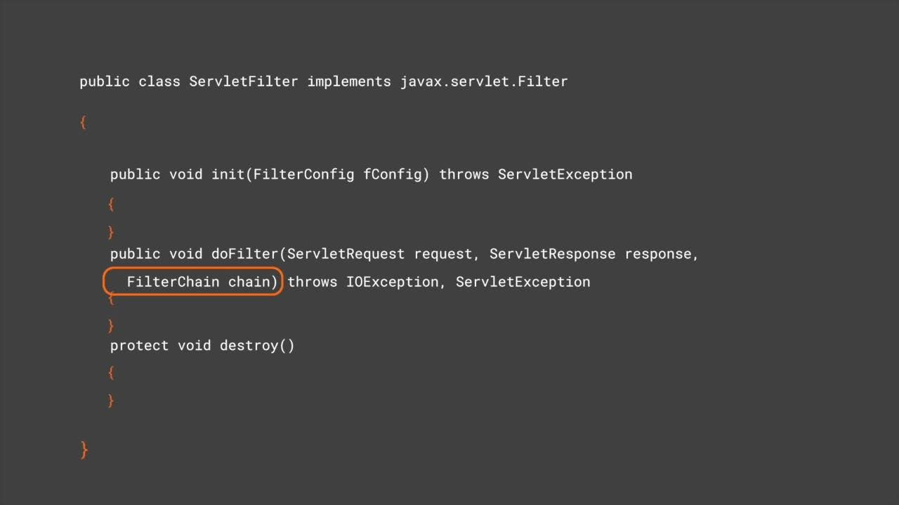

Slide 16
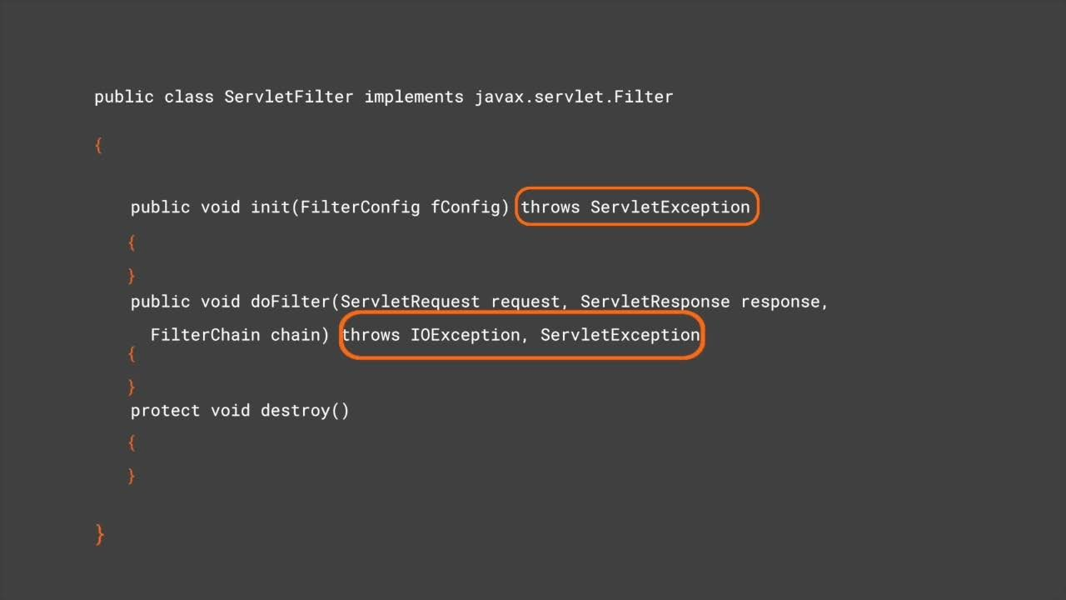

Slide 17
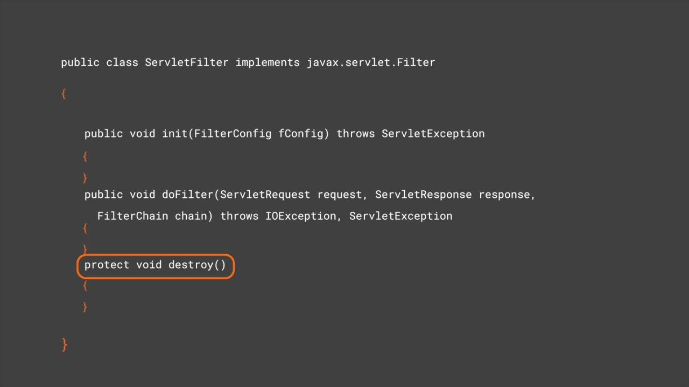

Slide 18
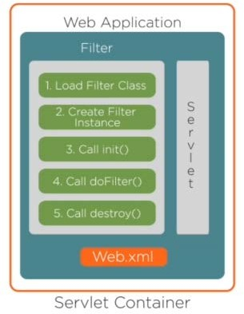
How a Filter Works
The web deployment descriptor(web.xml) declares that a filter should be invoked for a servlet
Web.xml applies all the filters associated with servlet For each filter the web container invokes
init(filterConfig)
doFilter(request,response,chain) destroy()
The filter class should call chain.doFilter()

Slide 19
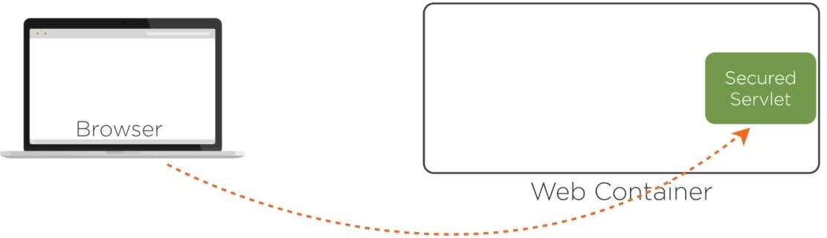
Assisted Practice: Servlets Filter Methods

Slide 20
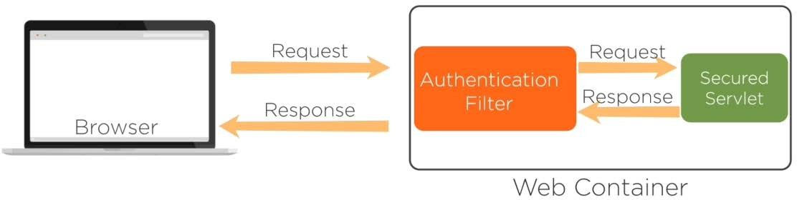
Assisted Practice: Servlets Filter Methods

Slide 21
Filter Mapping in web.xml

Slide 22
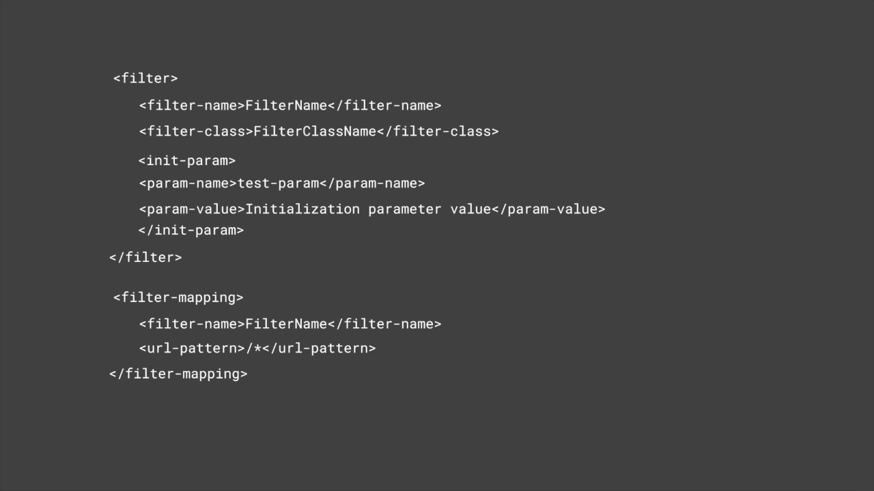

Slide 23

When to use Servlets Filter
How to create a Filter
Filter Mapping with Servlets

